Slide 1
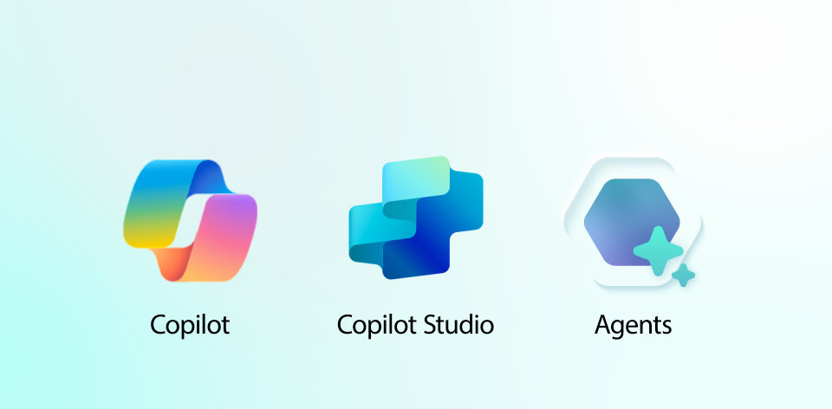

Microsoft– Agentic AI Partner Support Agent
Business Need
A team of customer support agents existed to provided partners with information regarding their qualifications for programs and incentives. A manual and time intensive process was done to answer questions based on multiple data sources and reports.
What we Did
Affirma developed a CoPilot agent using Copilot Studio to trained multiple data sources and Power BI reports that could answer questions from partners. The agent needed to understand the difference between data sources and make judgement decisions if there was any conflicting data.
Knowledge Base: Trained from 4 different data sets with a method for non-technical users to retrain the agent
Logging and Governance: Detailed logs of all communications for compliance and auditing requirements.
Streamline Process: Increased time to close support tickets by automating asks with Agentic AI and defaulting to support agents for less cases.
Results
Increased response time to partners by 50%
Reduced hours from human support agents by 20%
Notes:
Field Agent ABS Incentives Eligibility Impact

